Slide 1


NETWORK DEVICES . lecture 1
By.HUSAM ZENDAH

Slide 2
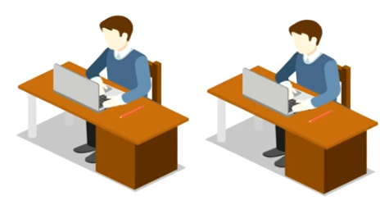
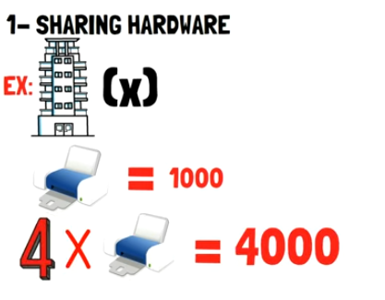

Slide 3



Slide 4



Slide 5






Computer Network
END HOST

Slide 6

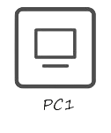

BUILDING A NETWORK

Slide 7

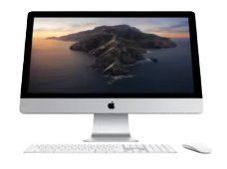

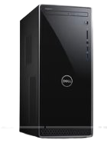
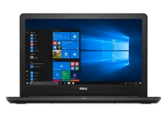
CLIENT

Slide 8


Slide 9
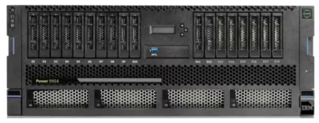


SERVERS

Slide 10




Slide 11



SEREVERS AND CLIENTS
server
Give me image.jpg
Here you are

Slide 12



SEREVERS AND CLIENTS
INTERNET
Your computer
YouTube SERVER
Give me the video, please
Here you are.

Slide 13


Slide 14

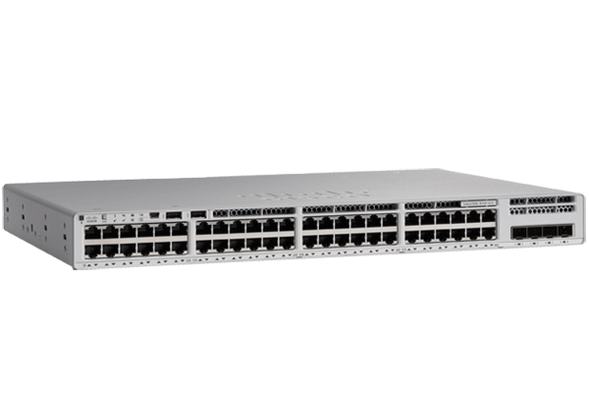


switch
Tripoli branch
cairo branch

Slide 15
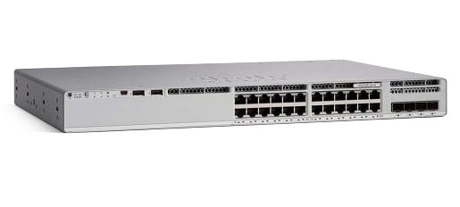
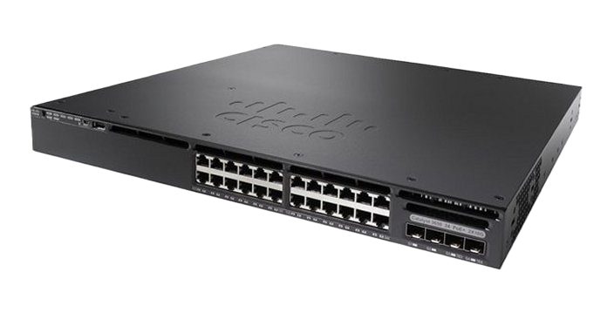

switch

Slide 16

Router

Slide 17

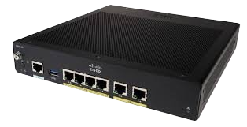
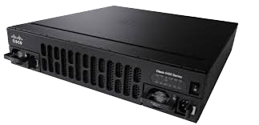

Router

Slide 18
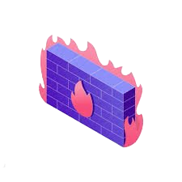

Firewall

Slide 19
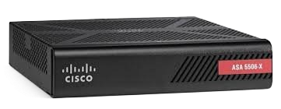
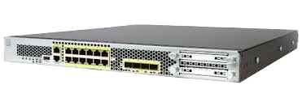

Firewall

Slide 20
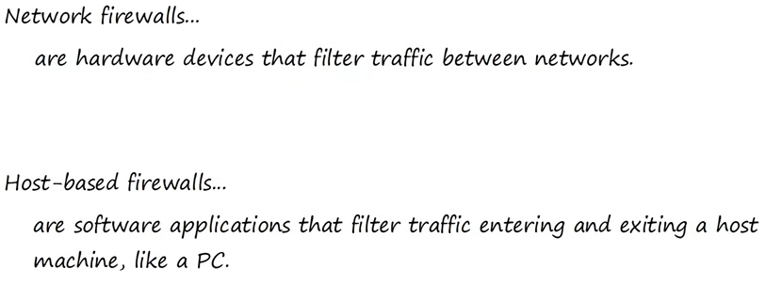

Slide 21


Slide 22
